Slide 1
Crunchbase Dataset: Predicting the success of a startup
Capstone Project 1

Slide 2
Problem statement
The crunchbase dataset contains information about several startups across the world. The startups are based out in several different industries like medicare, tech and finance. The problem statement is to determine whether the startups where successful or not taking several features into consideration.
We will consider a company to be a success if it IPOs or if it is acquired. We will also consider a startup a success if it has raised several rounds of funding. How many? Well, since all the startups in the CrunchBase database have already raised one round, we will pretend we are making a second round investment. We will also consider a startup a success if it has raised several rounds of funding. How many? Well, since all the startups in the CrunchBase database have already raised one round, we will pretend we are making a second round investment. Any companies that raise a third round will be considered successful as they have proven that other investors are interested in investing in this company after us.

Slide 3
Data Collection
The data from the crunchbase dataset is obtained by crunchbase API which sends the request, collects data and is stored in the json format.
Then the json file is imported to the Jupyter notebook and is stored in a dataframe in the form of a table.

Slide 4
Data Cleaning
The json format is converted into a dataframe and the description text with expressions, punctuations, adjectives and nouns are classified.
Some do not have descriptions and they are given the value 0. Then indicator columns are attached to different categories like cities, investors and headquarters.
We also gain information like funding round, funding amount mean, went for ipo, was acquired, founder names and number of founders, number of board members.

Slide 5
Exploratory Data Analysis
Clearly Acquired and IPOed are good indicators, but funding rounds appears to be a prerequisite to making it into the CrunchBase system.
Perhaps we can be more discerning in determining which companies that raised funds are considered successful, maybe a specific amount or number of rounds.
So, funding rounds are taken into consideration and especially the amount of funds raised.

Slide 6
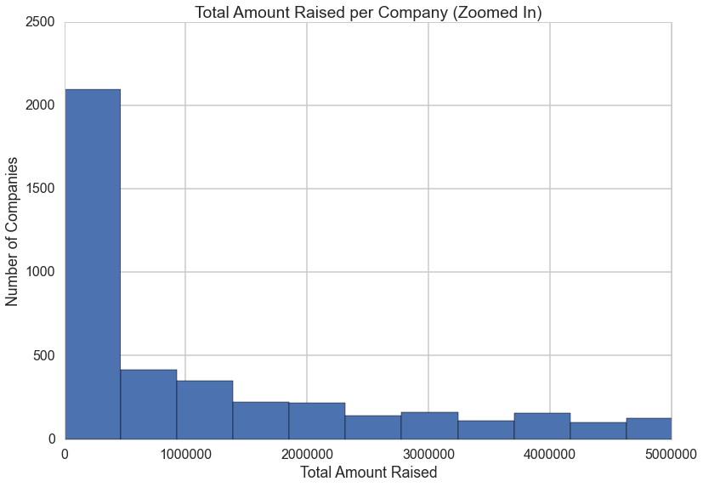
Exploratory Data Analysis
Total funds raised by the companies in the crunchbase dataset.

Slide 7
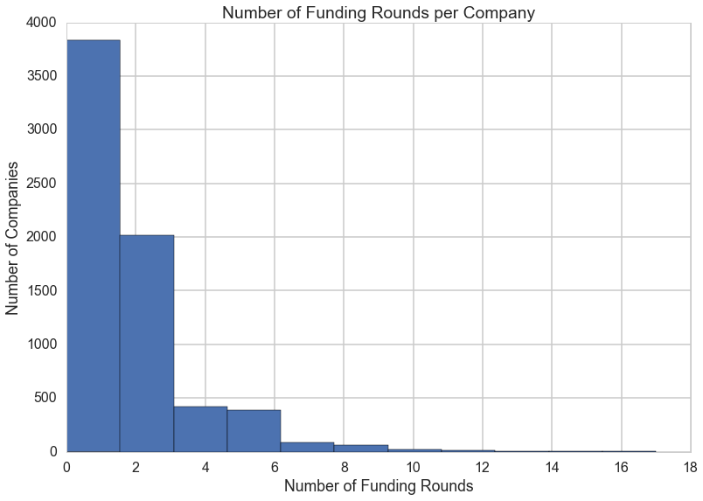
Exploratory Data Analysis
Number of rounds each company raised.

Slide 8
Exploratory Data Analysis
Again, we see that most companies are clustered near the bottom of our range with 0-3 rounds raised. 4 or more rounds raised is not very common.
Perhaps we can use that as an indicator of success, seeing as how it appears to be less sparse than the total amount raised column.
Perhaps this is due to the prevalence of companies and investors announcing that they raised a round, but not disclosing the exact amounts of that round. 1001 companies have raised at least 4 rounds.
After performing analysis on the success column, we can see that there is a wide range in the success percentage based on the category from 49% for Semiconductor companies to 10% for Consulting companies.
Then we will consider the cities that have a massive range in the success rate. Again, we see a massive range in the success rate, from 61% in Santa Clara down to 20% in Paris.

Slide 9
Baseline Model
Now we will attempt to find a baseline to improve upon. A basic baseline would be assuming that all companies fail or all companies succeed. Let's take a look at what those two assumptions would yield.
Accuracy of the model assuming all succeed: 0.33527696793 Accuracy of the model assuming all fail: 0.66472303207

Slide 10
Machine Learning Model: K Nearest Neighbors
We will perform a K-Nearest Neighbors classification to predict if a company will be successful or not based upon the training data.
The two categories into which we will be classifying our data are successful or not successful.
Let's graph the n_neighbors by accuracy, but with a balanced training set.
This is a useful method to use in data analysis when you have a skewed data set.
Here we will subsample our training set to build a balanced model where half of the data set is made of successful startups, and the other half is made of unsuccessful startups.
Since we have fewer successful companies than unsuccessful ones, we will downsample the unsuccessful ones to have the same number as successful.
Now that we have the right number of unsuccessful companies, we will recombined them with our successful companies to make our balanced dataset.
We'll start by iteratively running the balanced training set with a wide range of number of neighbors to find the best neighborhood of neighbors.
Best neighbors was 30 with max accuracy of 0.722852512156.

